Slide 1
AIT 590 final Project - SMS Spam Detection
By Team 05-002
Sushma Sree Kodru – G01229754
Sai Gaurav Daula – G01225856
Sai Shashank Vinnakota – G01221348

Slide 2

Abstract
This project helps us in letting us know if an incoming message is spam or not. This will help the users in prior understanding about the spam before viewing the SMS also it will protect the user from malware and secure their privacy. The challenging part of this project is that it is very easy to get access of an individual’s phone number, that will increase the probability of receiving a spam message. The interesting part of the project is that a user will be notified after he receives a spam message. Also, different spam patterns can be recognized and make it easier for the user to identify them.
To solve this problem of Cyber attacks we are building an application that could predict the SMS and alert the user if the message is a SPAM.

Slide 3
SMS SPAM DETECTOR – RELATED WORK
Contributions to the Study of SMS Spam Filtering. http://www.dt.fee.unicamp.br/~tiago/smsspamcollection/doceng11.pdf
JETIR 1805753. Jetir.org
http://www.jetir.org/papers/JETIR1805753.pdf
SMS Spam Collection v. 1.
http://www.dt.fee.unicamp.br/~tiago/smsspamcollection/
Spam Detection using NLP Techniques https://www.ijrte.org/wpcontent/uploads/papers/v8i2S11/B12800982S1119.pdf

Slide 4


SMS SPAM DETECTOR – PROBLEM STATEMENT
Problem Context
Domain of problem : Cyber attacks through SMS
Importance of problem : To detect the Spam SMS
Problem Statement
Relation between spam and ham messages.
Frequency: what words lead to spam messages.
SMS Detection: To predict using machine learning models if the message received is Spam or Ham.

Slide 5
SMS SPAM DETECTOR - DATA
Dataset
Data Source:
Our dataset is collected from the Grumble web site which is: http://www.grumbletext.co.uk/?. This dataset consists of spam and ham messages that are collected over years from trusted sources by the authors.
We have the total dataset for analysis without sampling it.
Dataset Owner : | Grumble
Dataset Type : | CSV
Messages : | 10,000 legitimate messages

Slide 6
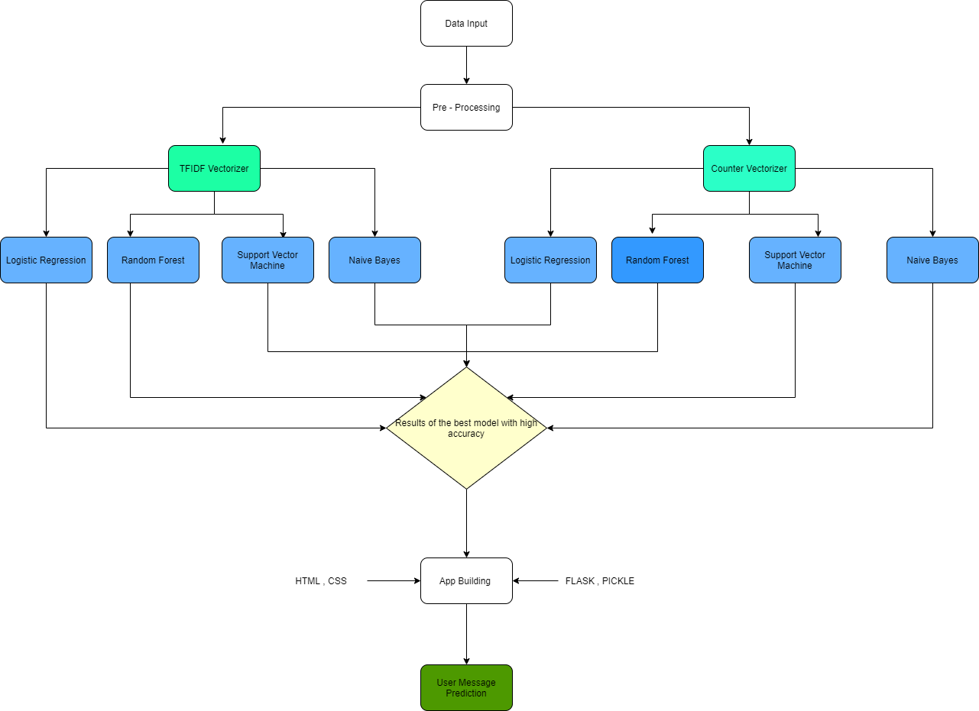
SMS SPAM DETECTOR – WORKING PLAN
Project Lifecycle

Slide 7
SMS SPAM DETECTOR – DATA DESCRIPTION
Data Description
# | Attribute | Description of code | Data type
1 | SPAM | Spam messages | Text
2 | HAM | Ham messages | Text

Slide 8
SMS SPAM DETECTOR – DATA PRE - PROCESSING
STEPS FOLLOWED
STOP WORDS REMOVAL
POS - Tagging
STEMMING
WORD FREQUENCY
CREATED LENGTH COLUMN
Data Pre-processing

Slide 9
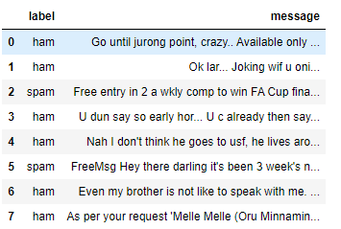
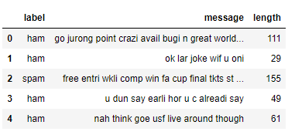
SMS SPAM DETECTOR – EXPLORATORY DATA ANALYSIS
Dataset Without Stop Words and Stemming
Dataset After using Stop Words and Stemming

Slide 10
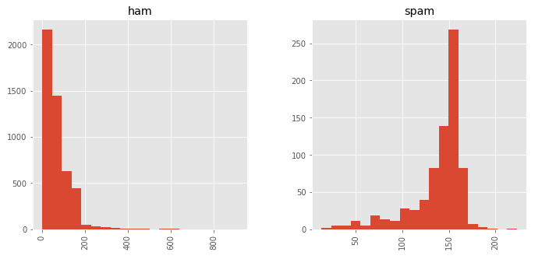
SMS SPAM DETECTOR – EXPLORATORY DATA ANALYSIS
We observed that the message is likely to be a Spam, if the length of the message is long.

Slide 11
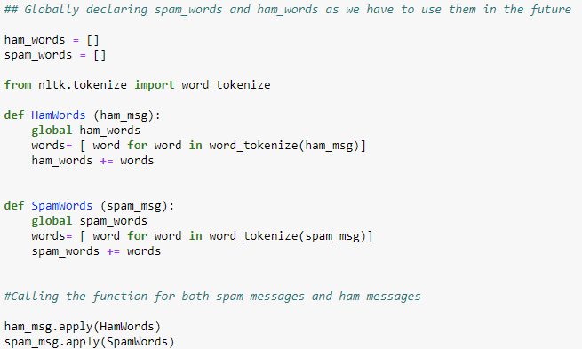
SMS SPAM DETECTOR – EXPLORATORY DATA ANALYSIS
Dividing the words into Spam words and Ham words

Slide 12
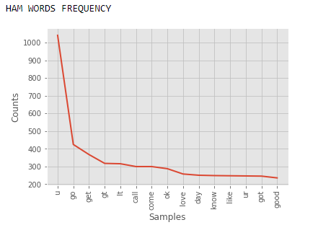
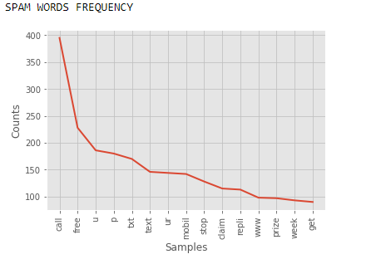
SMS SPAM DETECTOR – EXPLORATORY DATA ANALYSIS
We are interested in Spam words hence we can observe that when words like CALL, FREE, You and so on appear they are considered as a Spam message.

Slide 13
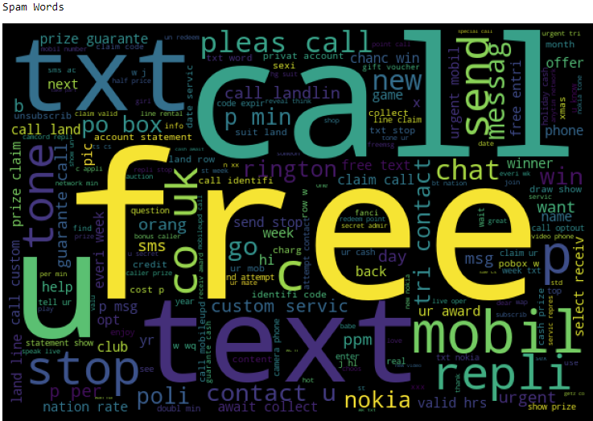
SMS SPAM DETECTOR – EXPLORATORY DATA ANALYSIS
Word Cloud function was used in order to understand the frequency of Spam words

Slide 14
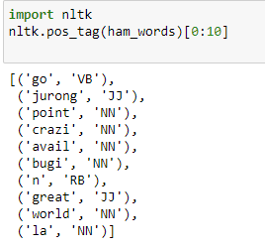
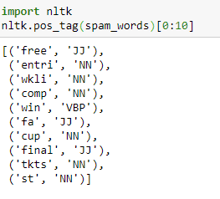
SMS SPAM DETECTOR – EXPLORATORY DATA ANALYSIS
Parts of Speech
To understand the parts of speech in both spam and ham words we have used pos_tag function and studied the results to check if we could draw any conclusions based on it.

Slide 15
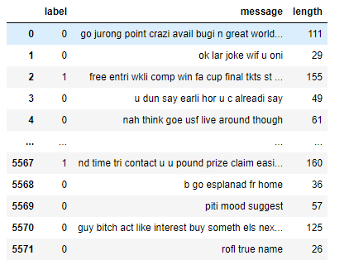
SMS SPAM DETECTOR – EXPLORATORY DATA ANALYSIS
Dataset without converting to number for Label column
Dataset after converting to number for Label column

Slide 16
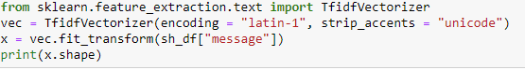
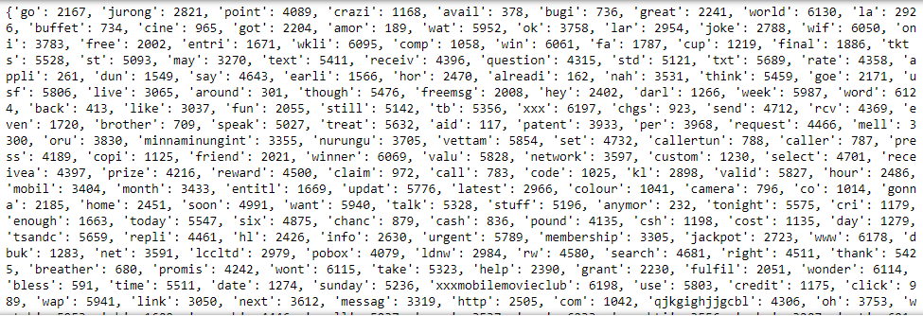
SMS SPAM DETECTOR - TDF – IDF VECTORIZOR
Using TF-IDF VECTORIZER
After using TF-IDF Vectorizer the words convert to numbers as the system cannot understand text, we convert it to numbers using vectorizer.

Slide 17
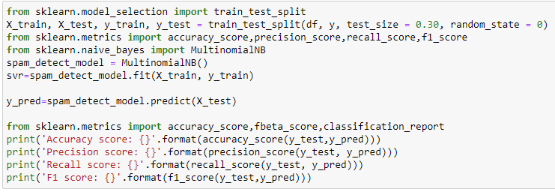
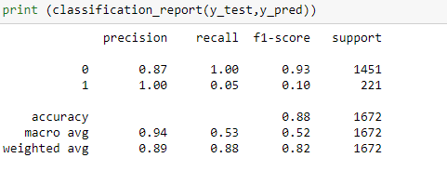
SMS SPAM DETECTOR - MACHINE LEARNING MODELS
Naïve Bayes – TF- IDF
Results:
Accuracy score Naive bayes classifier - TF-IDF vectorizer: 0.875
Precision score Naive bayes classifier - TF-IDF vectorizer: 1.0
Recall score Naive bayes classifier - TF-IDF vectorizer: 0.05429864253393665
F1 score Naive bayes classifier - TF-IDF vectorizer: 0.10300429184549356
MSE Naive bayes classifier - TF-IDF vectorizer: 0.125

Slide 18
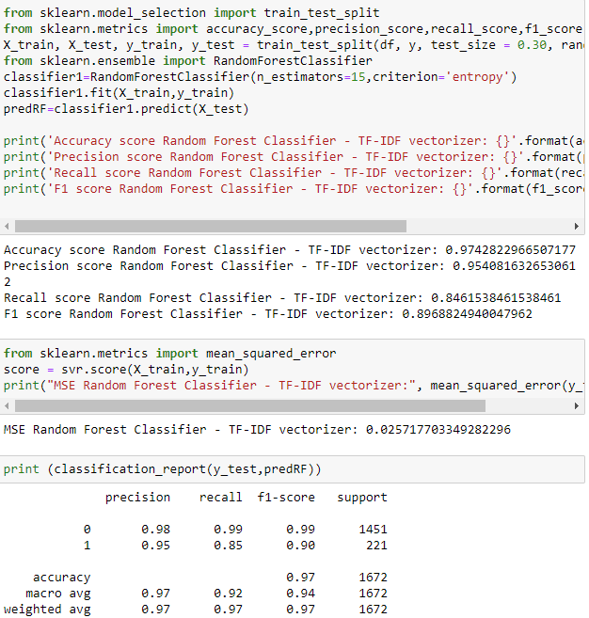
SMS SPAM DETECTOR - MACHINE LEARNING MODELS
RANDOM FOREST-
TF-IDF

Slide 19
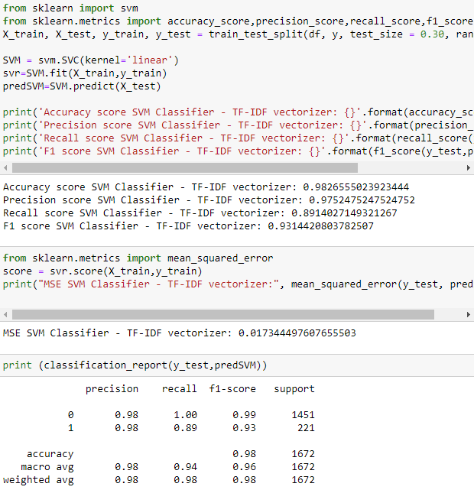
SMS SPAM DETECTOR - MACHINE LEARNING MODELS
SUPPORT VECTOR MACHINE-
TF-IDF

Slide 20
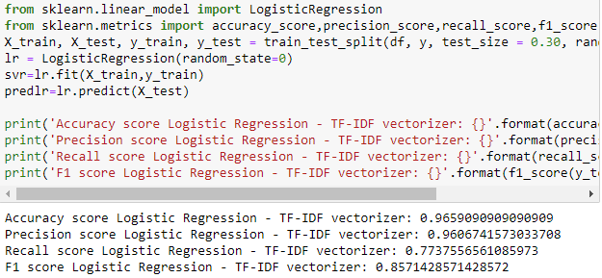
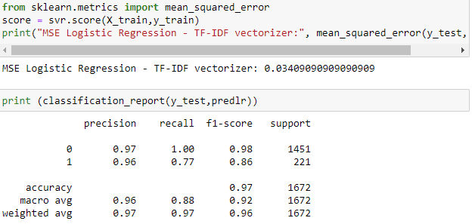
SMS SPAM DETECTOR - MACHINE LEARNING MODELS
LOGISTIC REGRESSION-
TF-IDF

Slide 21
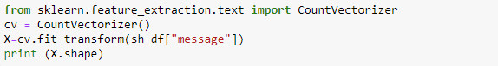
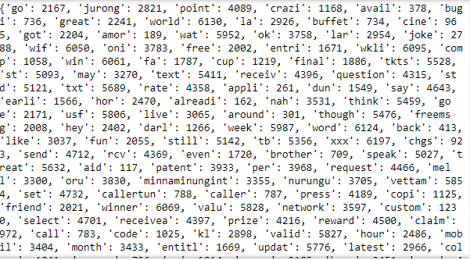

SMS SPAM DETECTOR - COUNTER VECTORIZER
Using COUNTER VECTORIZER
After using COUNTER Vectorizer the words convert to numbers as the system cannot understand text, we convert it to numbers using vectorizer.

Slide 22
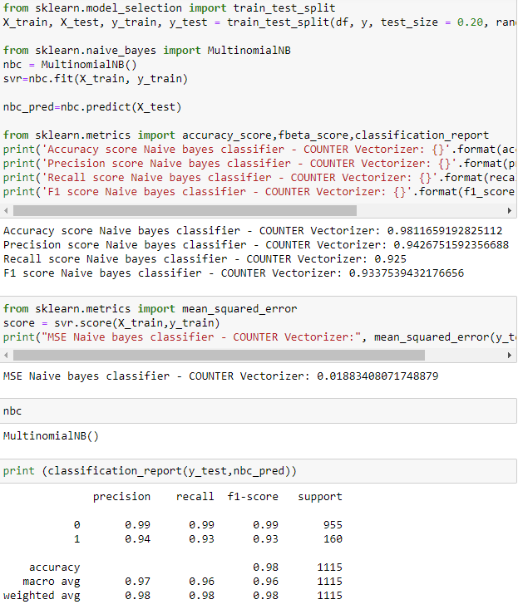
SMS SPAM DETECTOR - MACHINE LEARNING MODELS
NAÏVE BAYES
COUNTER VECTORIZER

Slide 23
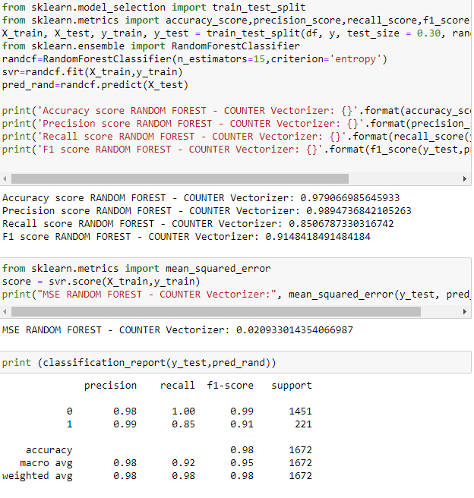
SMS SPAM DETECTOR - MACHINE LEARNING MODELS
RANDOM FOREST-
COUNTER VECTORIZER

Slide 24
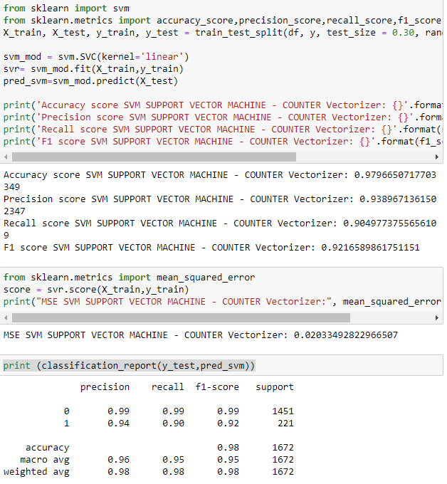
SMS SPAM DETECTOR - MACHINE LEARNING MODELS
SUPPORT VECTOR MACHINE-
COUNTER VECTORIZER

Slide 25
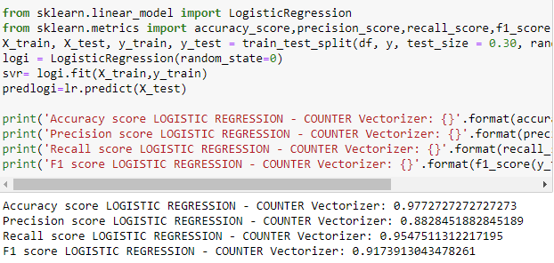
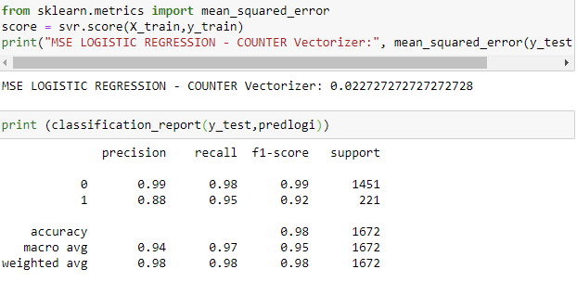
SMS SPAM DETECTOR - MACHINE LEARNING MODELS
LOGISTIC REGRESSION- COUNTER VECTORIZER

Slide 26
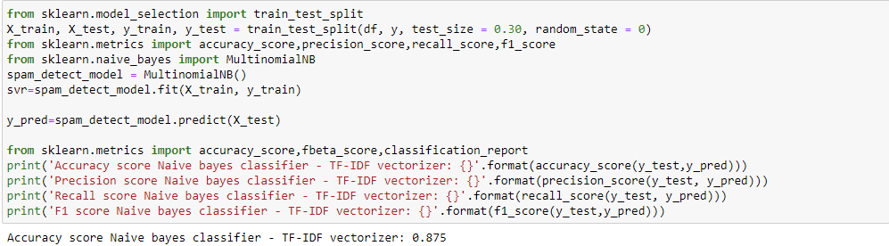
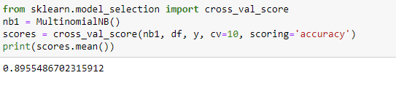
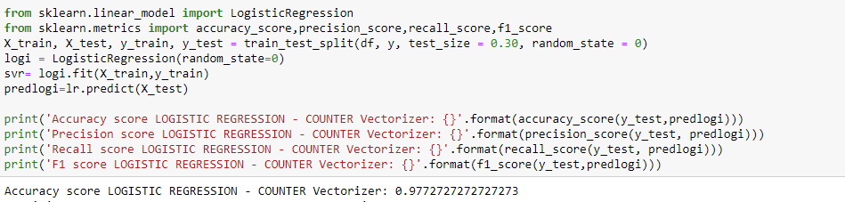
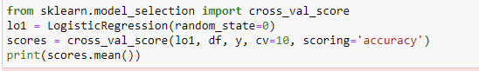
SMS SPAM DETECTOR - K-FOLD CROSS VALIDATION
Without Cross Validation
With Cross Validation
Naïve Bayes
Logistic Regression

Slide 27
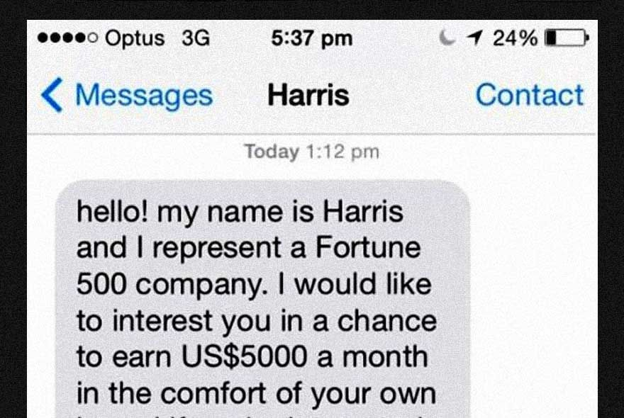

SMS SPAM DETECTOR - RESULTS
We found out that the least performing model is the Naïve Bayes with TF-IDF vectorizer with an Accuracy of 87.5%.
We have increased its accuracy to 90 % using Cross validation technique
We found out that there are 2 models that performed very good Naïve Bayes with counter vectorizer and SVM with TF-IDF vectorizer having 98.1% and 98.2% respectively.
Hence, we have decided to randomly choose one for the model that we would use for further analysis.
We chose SVM with TF-IDF in the application for predicting the user messages if they are spam.

Slide 28
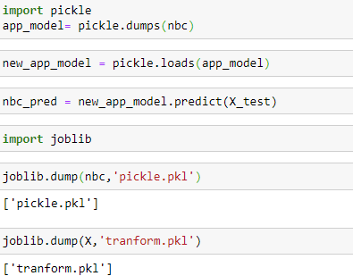

SMS SPAM DETECTOR – APPLICATION CODE
We have used pickle function to dump the model that we would like to use for the application.
Then we have generated two pickle files:
pickle.pkl
tranform.pkl
Pickle.pkl is the file that contains the machine learning model that is Naïve bayes.
Tranform.pkl file contains the vector array which is the transformed file after using counter vectorizer.

Slide 29
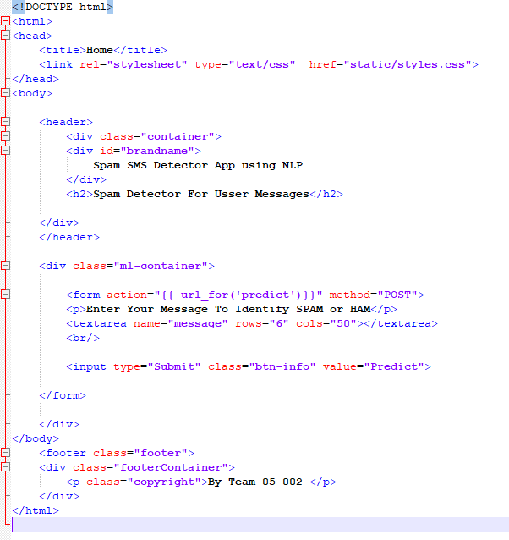
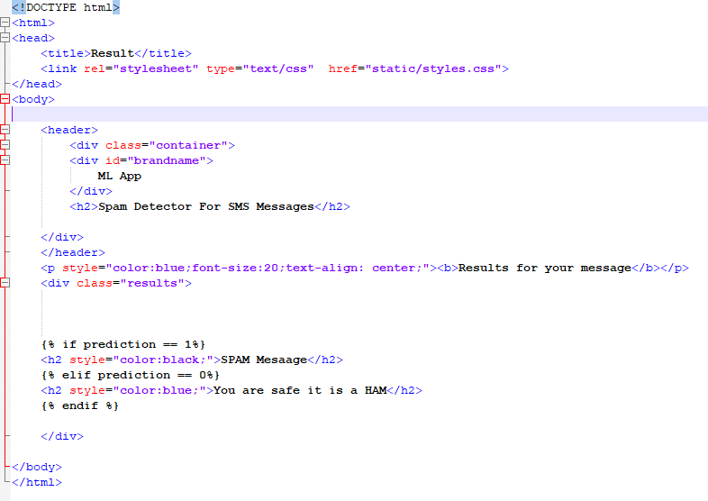
SMS SPAM DETECTOR – HTML
We have used two html files – Home and Result
Home file is the interface that the user sees when he opens the application
Result file is the interface the user sees after he clicks on predict button to check if his message is spam or not
Home.html
Result.html

Slide 30
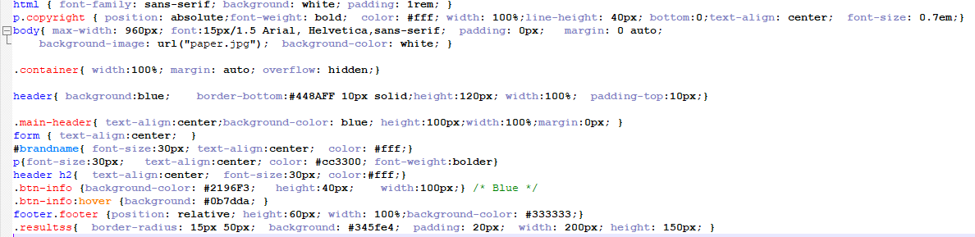
SMS SPAM DETECTOR - CSS
CSS commands have been used in order to build styling of the application and the next slide would display the interface of it.

Slide 31
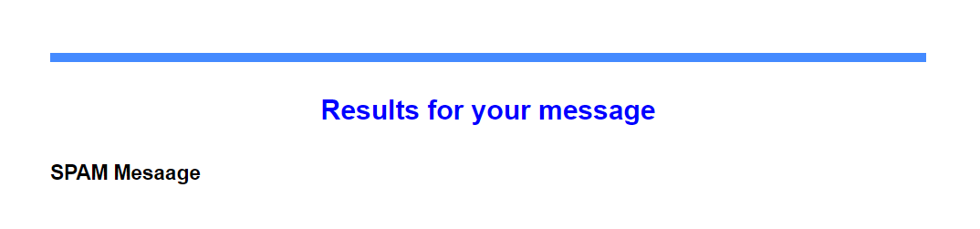
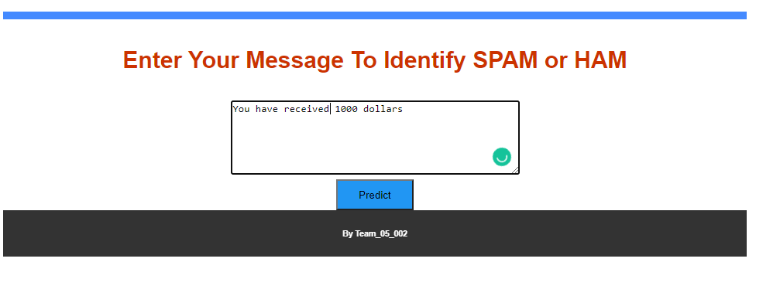
SMS SPAM DETECTOR – RESULTS / CONCLUSION
We can clearly see that after we enter the message “You have received 1000 dollars” as input we can see that we get an output that our model predicted is it is Spam Message.
We have used NLP techniques in order to understand and read the text and perform analysis on the data and then we have used machine learning techniques and models to predict users' messages, we have even used flask and pickle in order to build a local server by applying html and Css for design and have achieved 98.2% accuracy that is 3% more accurate than the papers that we have referred to.

Slide 32
SMS SPAM DETECTOR – PPOTENTIAL ANALYTICS / ALGORITHM
Algorithms used : Naïve Bayes, Random Forest, Support Vector Machine, Logistic Regression.
Dataset : Spam dataset from Grumble
Computer Requirements : Win.10
Web Design : HTML, CSS, FLASK
Platform : Python 3
For future work we would like to use word embedding and test the data accuracy we would even try to involve other vectorizers in order to consider the accuracy area and then use the best model for predicting the spam messages.

Slide 33

SMS SPAM DETECTOR
ANY QUESTIONS?

